Slide 1


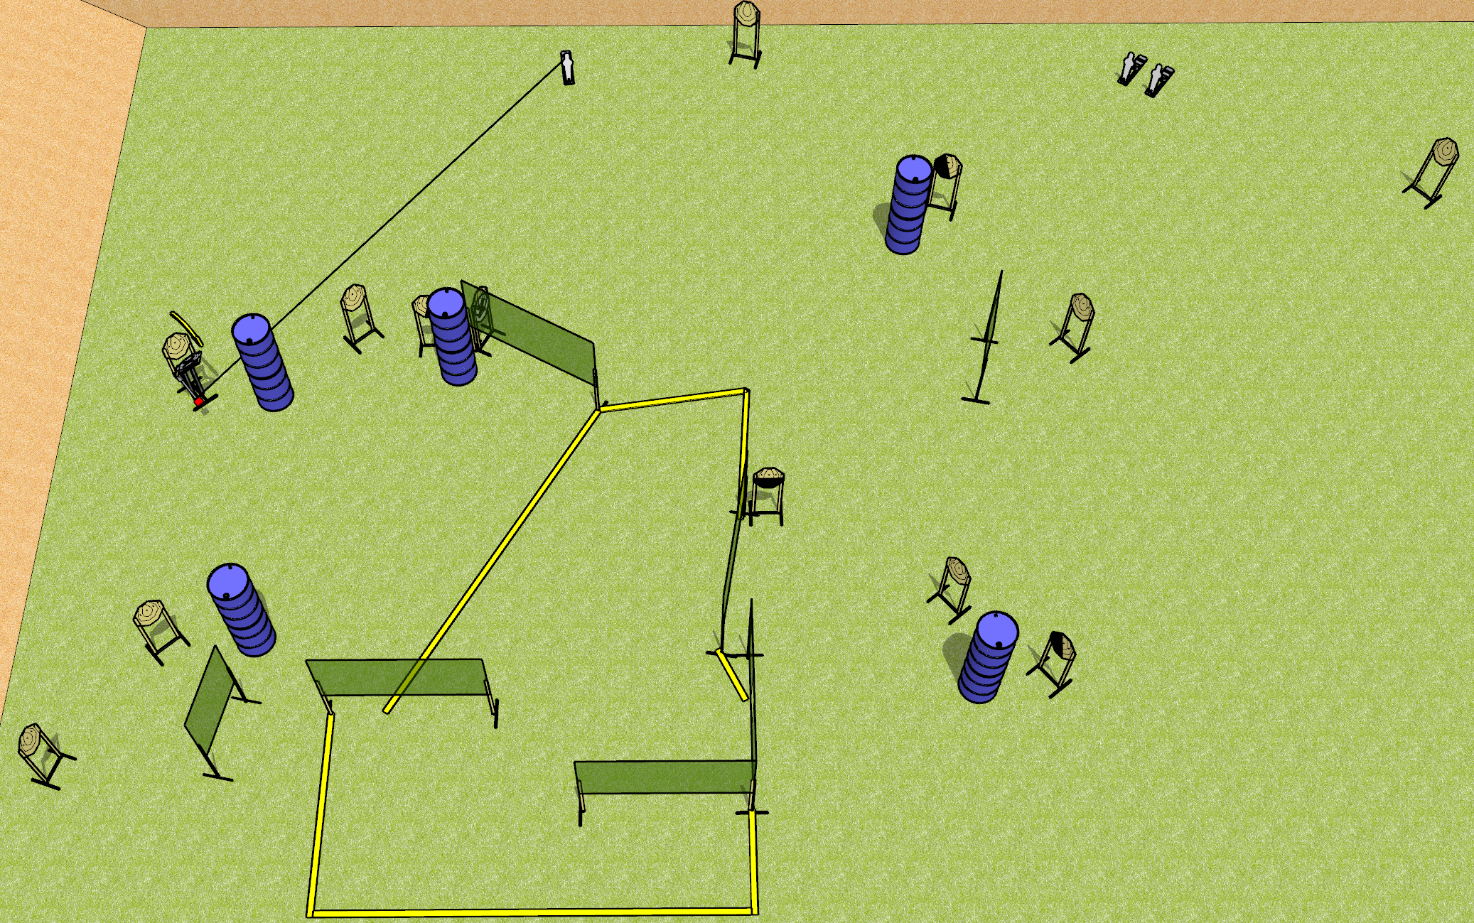
 | Dothan Gun Club – USPSA Match Matches Will Go On Course Designer : Drew Coleman Bay: 7
Round Count 29 rounds 13 IPSC 3 mini poppers
Equipment List 13 wall feet Max trap + activator 2 left + 1 right diag, 1 50%, 11 targets (9 + 2NS)

Slide 2
Matches Will Go On
Written Stage Briefing
Scoring: Comstock Rounds: 29
Targets: 13 IPSC, 3 steel
Handgun start position: anywhere completely outside the shooting area, wrists below belt. Handgun is loaded and holstered.
PCC start position: anywhere completely outside the shooting area, stock on belt. Loaded carbine is held with both hands, safety on.
Stage Procedure: On the audible start signal, engage targets as they become available from within the shooting area. The max trap is activated by P1 and remains visible at rest.

